Slide 1
EQUIP Program
Planning & Scheduling Training
April 18, 2023

Slide 2
Dave Livingston
Group Director of Planning & Scheduling
Alabama, Tennessee, Texas
B.E. Civ.E.; Vanderbilt University
M.E. Construction Mgmt.; Vanderbilt University
18 years in the Industry
Precon, Project Mgmt, Planning & Scheduling

Slide 3
Dan Gilmour
Group Director of Planning & Scheduling
Carolinas, Georgia, Florida
B.E. Civ.E.; Carnegie Mellon University
16 years in the Industry
Precon, Project Mgmt, Planning & Scheduling

Slide 4
Intro to Scheduling & Terminology
Schedule Development Lifecycle
Understanding a P6 Schedule
Maintaining & Updating
Reporting

Slide 5
INTRO TO scheduling & TERMINOLOGY

Slide 6
Schedule Development Building Blocks
WBS
Activities
Durations
Relationships

Slide 7
WBS
Planning Outline | Work Breakdown Structure (WBS)

Slide 8
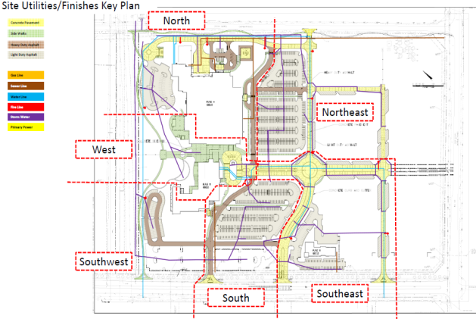
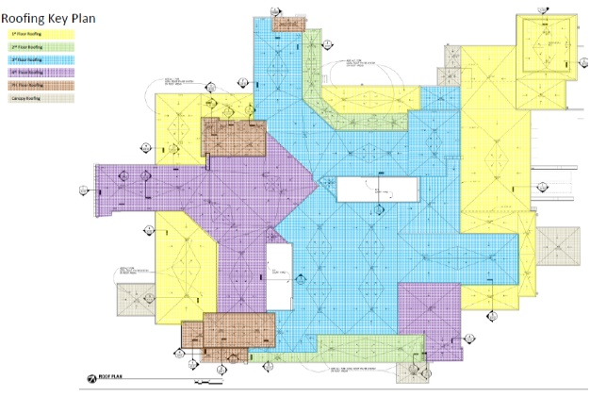
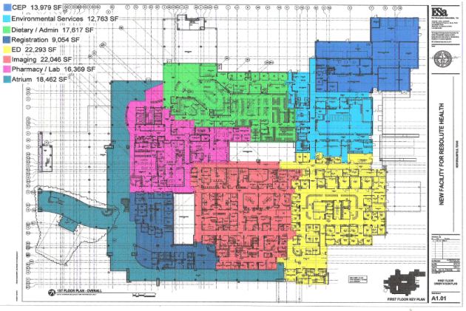
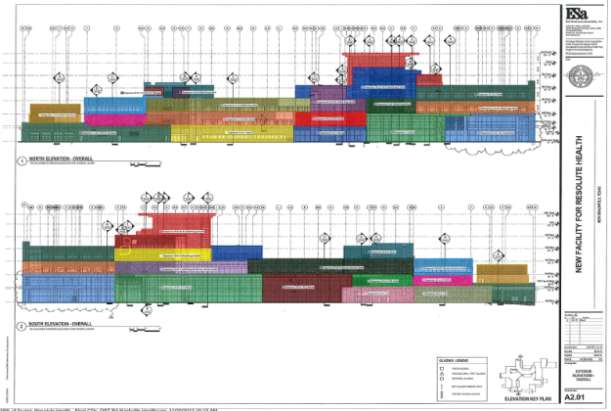
WBS and Work Activities
Key Plans
Key Plans create the geographical language in the project schedule
Considerations:
Areas of similar finish
Turnover milestones
Directional workflow
Equipment
Safe working conditions

Slide 9
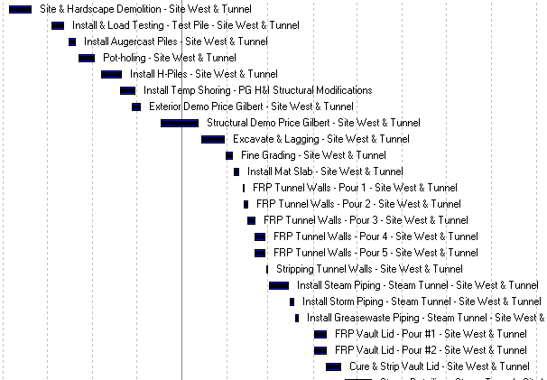
Activities
What makes an activity?
Activities consume time
Activities consume resources
Activities have a definable start and finish
Activities are measurable

Slide 10
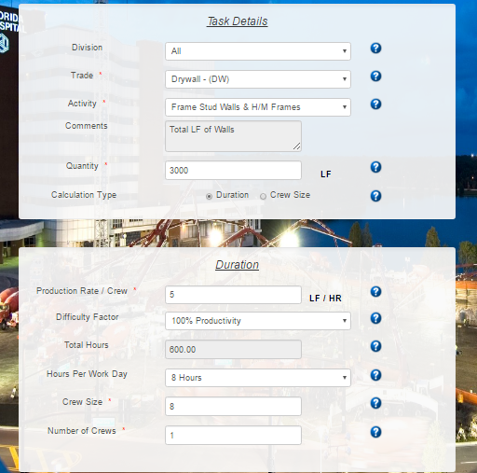
Durations
Durations
Durations should be meaningful
No dart throws!
Use quantity take-offs and production rates to calculate durations
Don’t neglect resource considerations

Slide 11
Relationships
Types of Relationships
Physical (hard logic)
Preferential (soft logic)
Safety
Resource
Access
Types of Relationship Logic
Finish to Start (FS)
Start to Start (SS)
Finish to Finish (FF)
Start to Finish (SF) – not to be used
In a “complete” network only one activity will not have a predecessor and only one activity will not have a successor

Slide 12
Scheduling Terms - Relationships
Finish to Start
300
Place Footings
Columns 1 – 7
2
ES EF
LS LF
TF FF
310
Place Footings
Columns 8 - 14
2
ES EF
LS LF
TF FF
320
Place Footings
Columns 15 - 21
2
ES EF
LS LF
TF FF

Slide 13
Scheduling Terms - Relationships
Start to Start
300
Haul In Structural Fill
10
ES EF
LS LF
TF FF
310
Site Grading
10
ES EF
LS LF
TF FF
320
Building Layout
2
ES EF
LS LF
TF FF

Slide 14
Scheduling Terms - Relationships
Finish to Finish
300
Haul in Structural Fill
10
ES EF
LS LF
TF FF
310
Site Grading
10
ES EF
LS LF
TF FF
320
Building Layout
2
ES EF
LS LF
TF FF

Slide 15
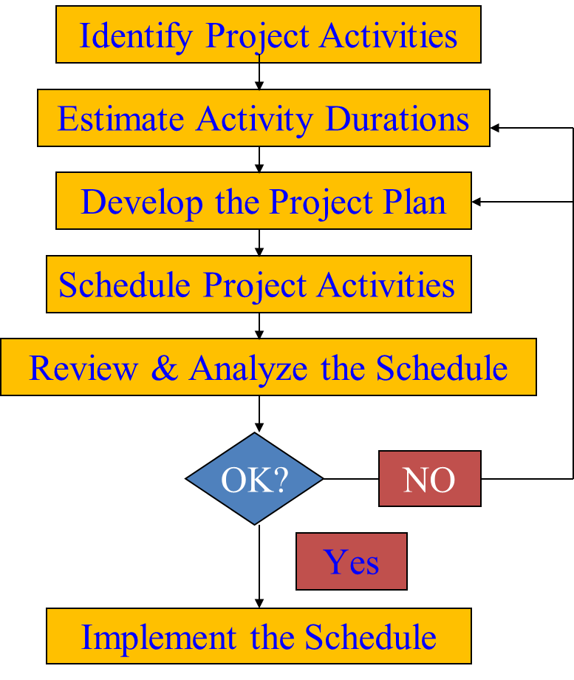
Planning Lifecycle

Slide 16
Scheduling Terms - Dates
Data Date
The date on which the schedule has been updated to reflect actual progress and upon which the network projects a new completion date.
The calendar date that separates actual (historical) data from scheduled data. Scheduling software uses the data date to base its network calculations.
Early Start or Finish
Earliest dates an activity can start and finish once its predecessor network is completed. Activities start as soon as possible if not prevented by logic. Calculated through forward CPM pass.
Start and Finish on P6 = early dates
Late Start or Finish
Latest dates an activity can start and finish without delaying the end date of the project. Calculated through backward CPM pass.

Slide 17
Scheduling Terms - CPM
Critical Path Method (CPM)
Data network calculation that considers:
Activity durations
Project calendars
Logic relationships
TO
Conduct a forward calculation through the network
Conduct a backward pass through the network
AND
Establish network paths and timeframes to project completion

Slide 18
Scheduling Terms - Float
Total Float
The amount of time an activity can slip from its Early Start without delaying the project
The difference between an activity’s late dates and early dates
TF = LS – ES
or
TF = LF – EF

Slide 19
Scheduling Terms - Float
Types of Total Float
Positive Float – activity can be delayed without delaying project completion date
Zero Float (critical) – activity cannot be delayed without delaying project completion date
Negative Float (extremely critical) – activity is behind schedule and has delayed project completion date

Slide 20
Scheduling Terms - Paths
Critical Path vs. Longest Path
The longest path is the path through the network that establishes the minimum overall project duration.
The critical path can be defined by its amount of float
A project can have multiple critical paths, but only one longest path.
Near critical path
An activity or set of activities that are almost critical or at risk of becoming critical if delayed past their expected completion times. Inclusion in this list may be made by using total float, longest path value, or multiple critical paths.

Slide 21
schedule development

Slide 22
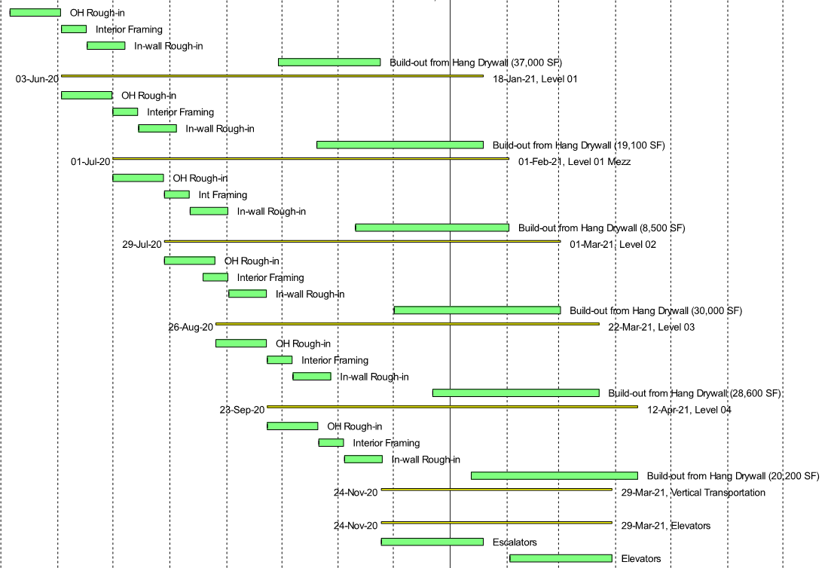
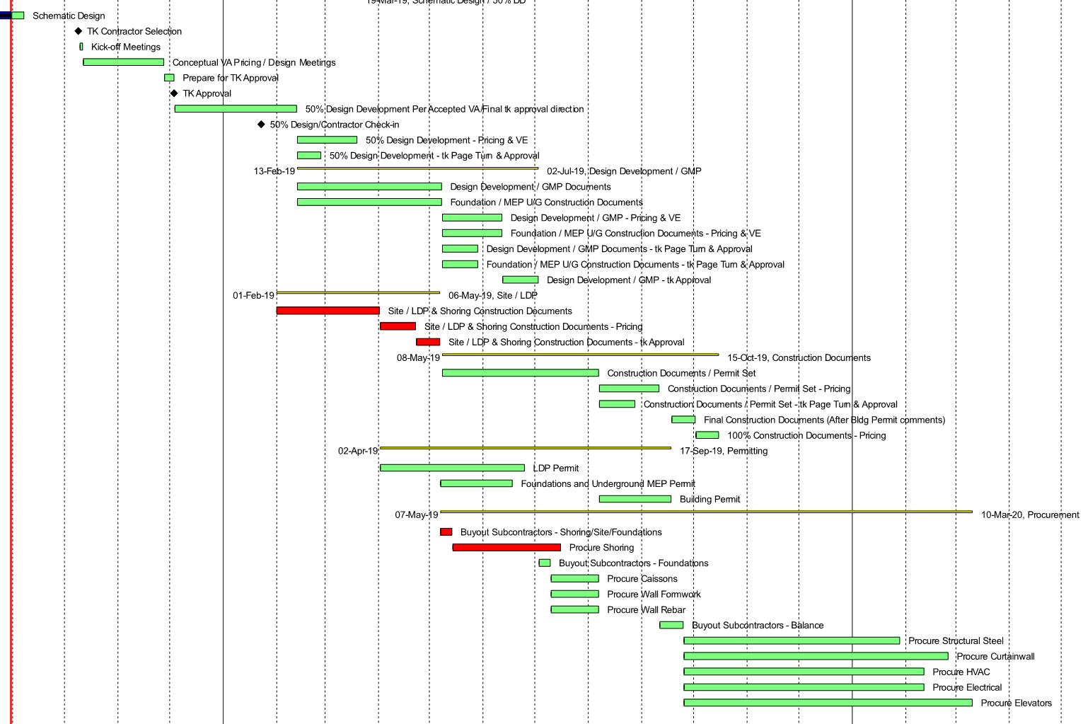
Schedule Development Lifecycle
Bid Schedule

Slide 23
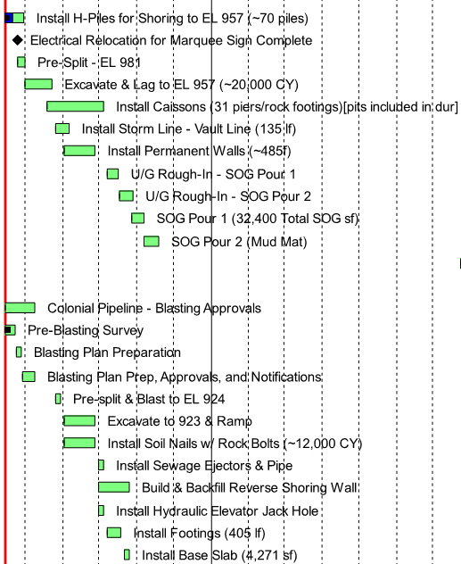
Schedule Development Lifecycle
Initial Baseline Schedule
Generally due 15 days from NTP
Full Detail for first 60 days of Construction

Slide 24
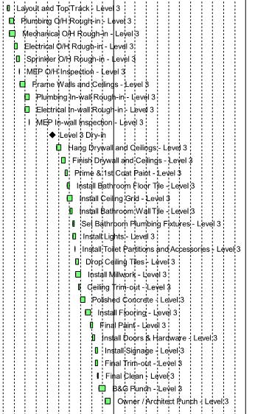
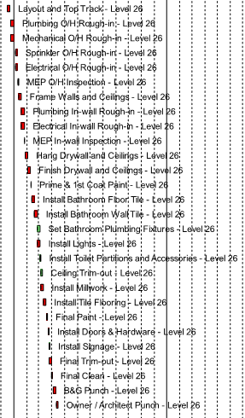
Schedule Development Lifecycle
Baseline Schedule
Generally due 60 days from NTP, Full Construction Detail

Slide 25
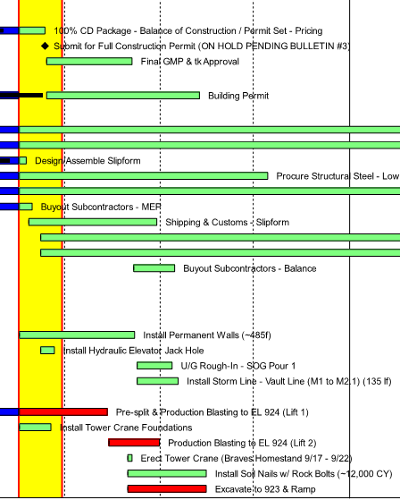
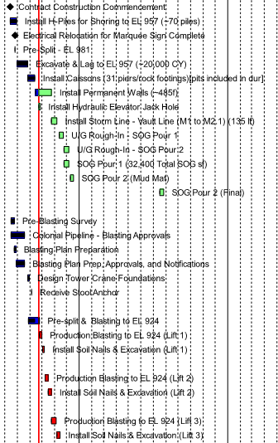
Schedule Development Lifecycle
Schedule Updates
At very least, monthly frequency

Slide 26
understanding a p6 schedule

Slide 27
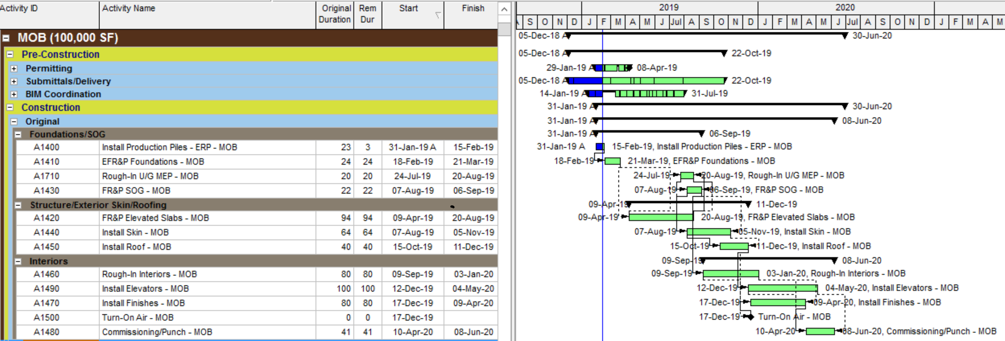
Reading a P6 Schedule
Time Scale
Gantt Chart & Timescale
Data Date - starting point for schedule calculations and it is used to schedule all remaining work.
Chart Legend
Level of Effort – Summary Bar
Actual Work - Past
Remaining Work – Today / Future
Critical Activities – Total Float is less than or equal to 0
Milestone – Point in time
WBS
Banding
Activity Table
Gant Chart
PAST
FUTURE
Data
Date

Slide 28
managing & updating

Slide 29
Legal Considerations
In the beginning, the schedule sets the plan.
In the end, the schedule tells the story.

Slide 30
Legal Considerations
The schedule is the historical record of the project
A Successful Schedule Program:
Thorough Planning
Frequent Updates
Accurate Updates
Documentation of Changes

Slide 31
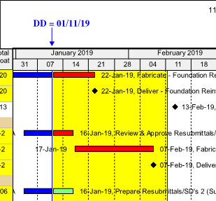
Components of an Update Form
Data Date
An update form will be filtered to a specific time period from the established data date (i.e. 6-Week Lookahead, 8-Week Lookahead, etc.)
The data date refers to the date of the update. Anything prior to this date will have been started or completed.

Slide 32
Components of an Update Form
Columns
The columns found on an update form may be:
Activity ID
Activity Name
Remaining Duration
New Remaining Duration (not shown above)
Actual Start
Actual Finish
Expected Start
Expected Finish
Generally, blank cells indicate information needed to update the schedule

Slide 33
Filling out an Update Form
Activity Status
Actual Start & Actual Finish: The actual start/finish date of the activity. An “Actual” can not be in the future.
Remaining Duration: If you have started the activity and know how many days it will take to complete, your remaining duration will be days remaining to complete from the data date.
Expected Starts/Finishes: Anticipated future dates.
No Update: This indicates no progress made. When no update is provided, provide an explanation as to why.
Provided update notes may be handwritten or typed, but should be legible and in a different color than the rest of the update form.

Slide 34
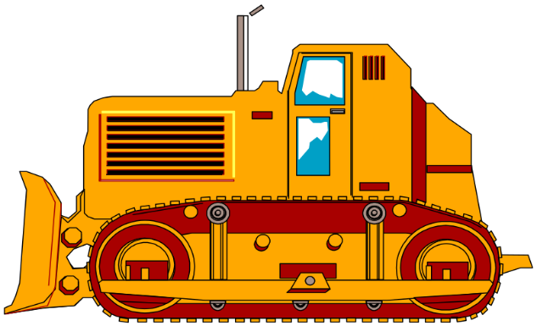
Filling out an Update Form
Moving the Data Date
What does it mean when the data date is moved?
The data date is moved forwards for every update, from the previous update date to the current update date. When your data date moves forwards, anything that has not been started or finished will be affected by this push.

Slide 35
Proper Update Form

Slide 36
REPORTING

Slide 37
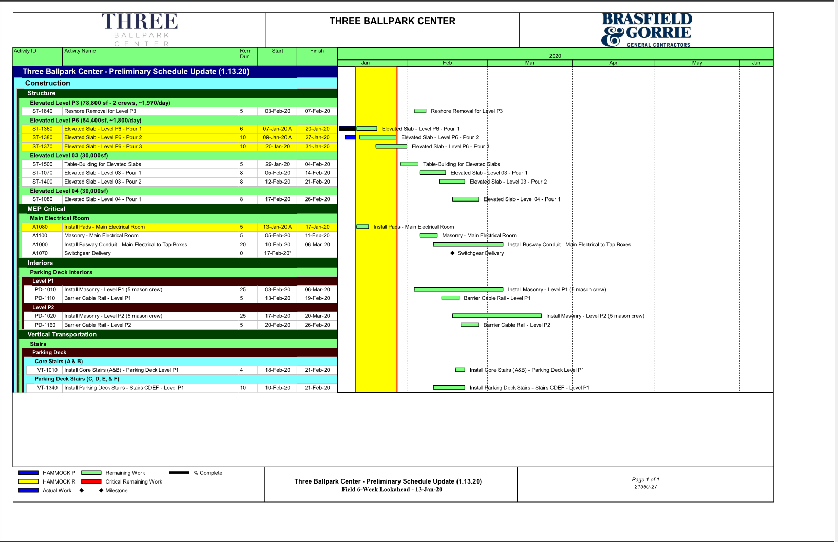
Schedule Reports - Lookaheads

Slide 38
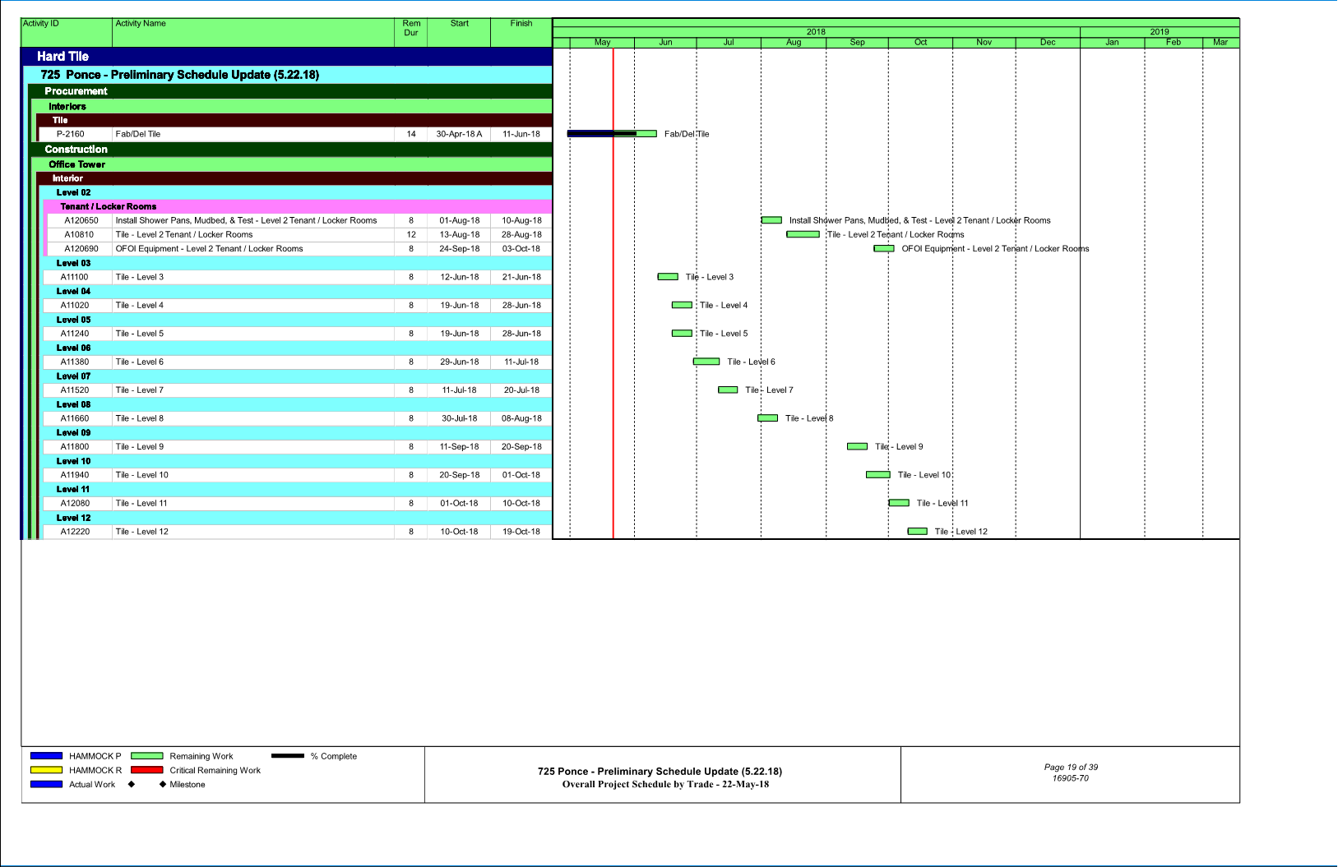
Schedule Reports – Trade Sorts

Slide 39
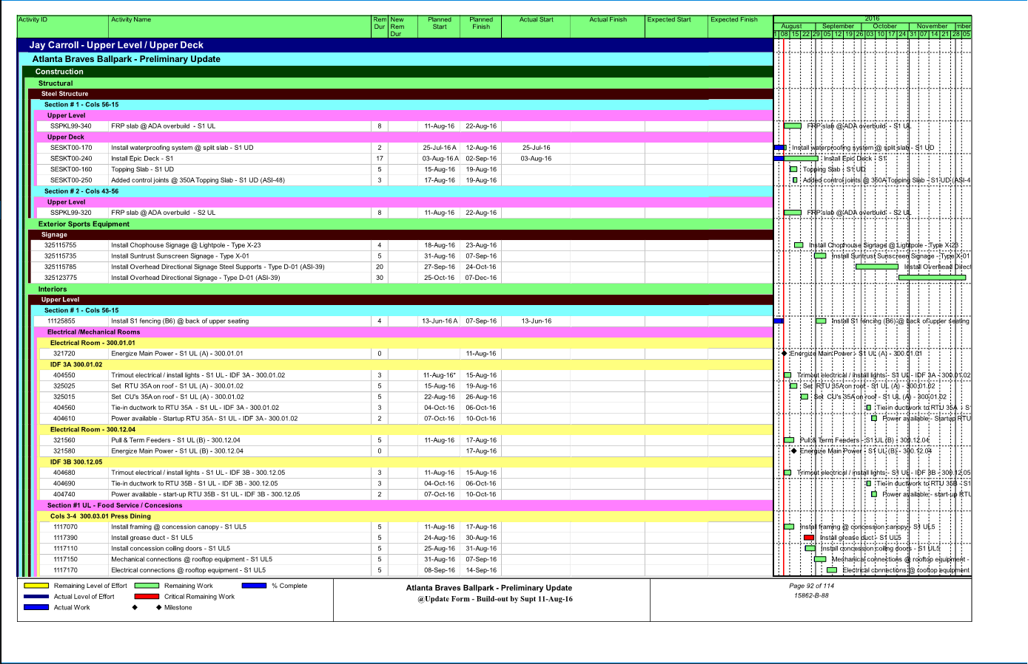
Schedule Reports – Scope Sorts

Slide 40
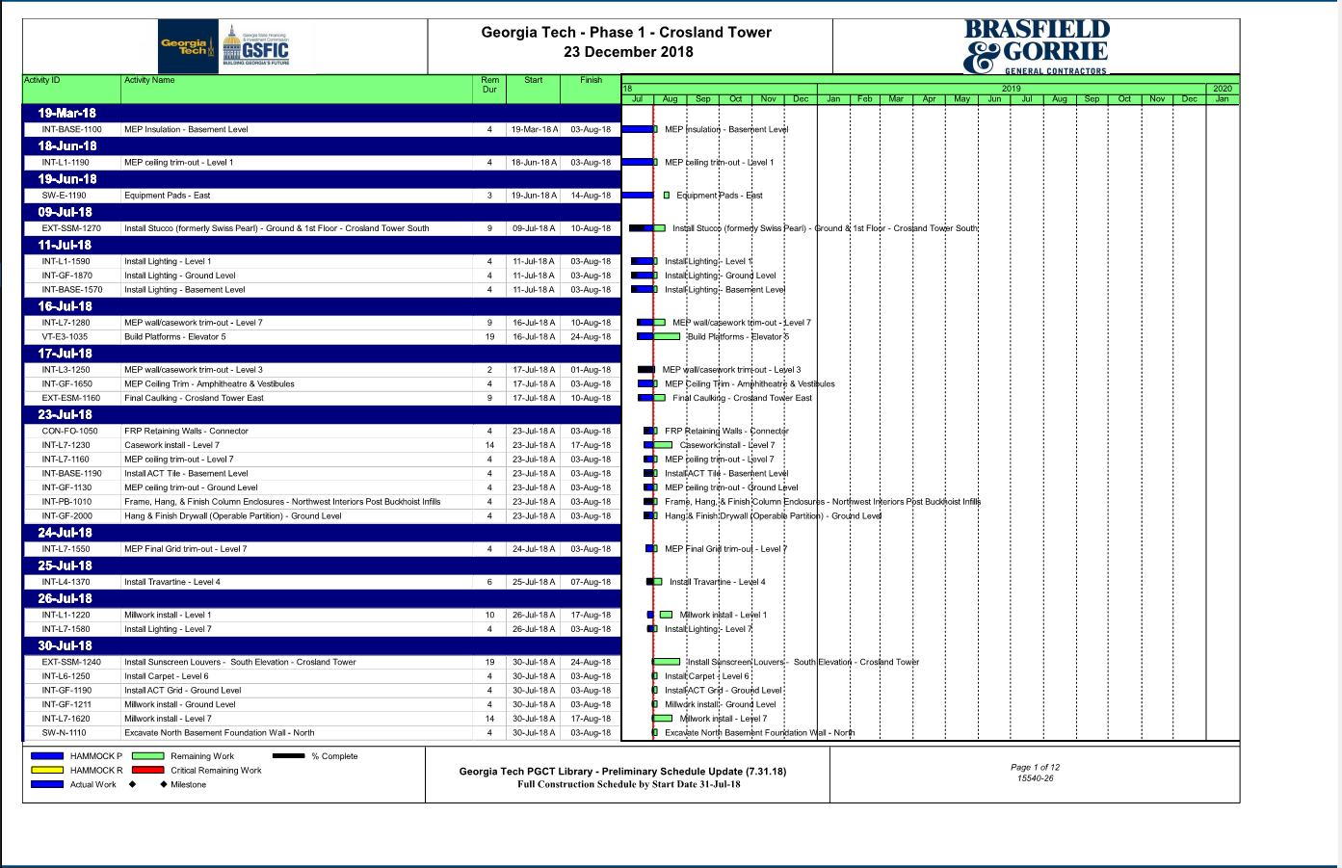
Schedule Reports – Start Dates

Slide 41
Schedule Reports – Gannt Chart

Slide 42
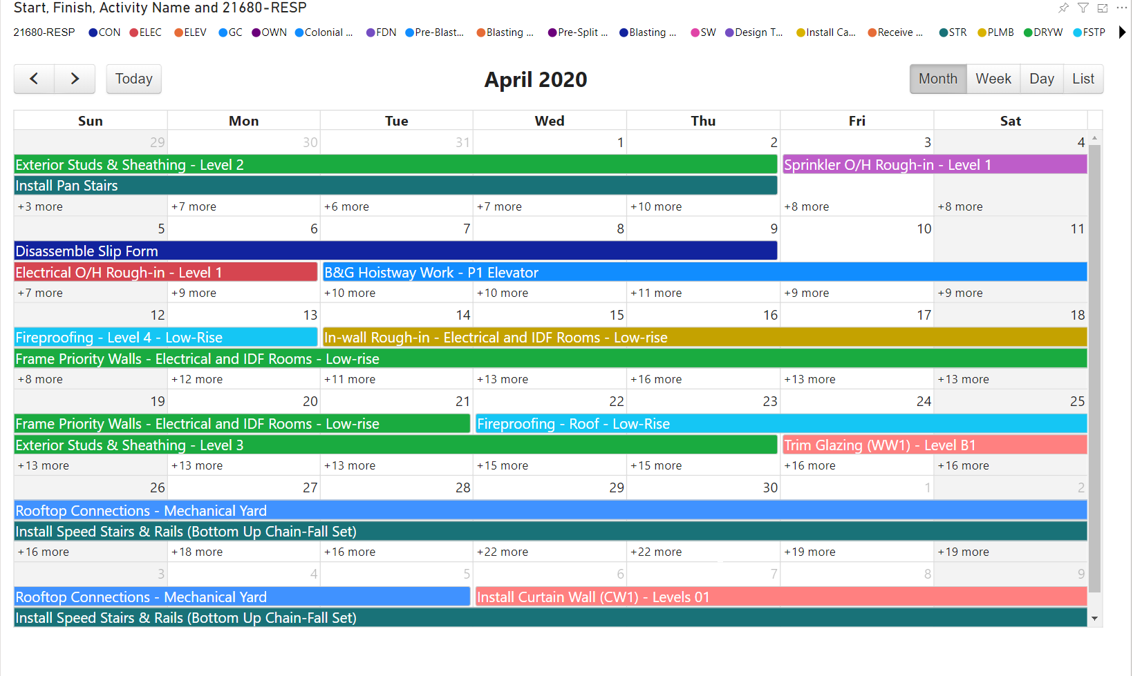
Schedule Reports – Calendar View

Slide 43
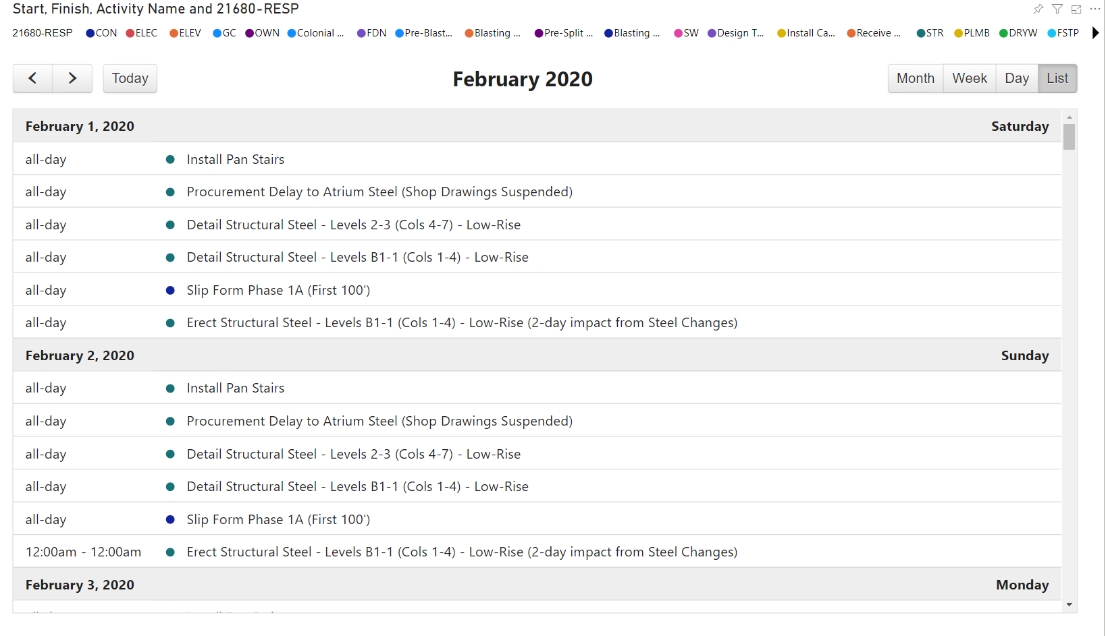
Schedule Reports – Calendar View

Slide 44
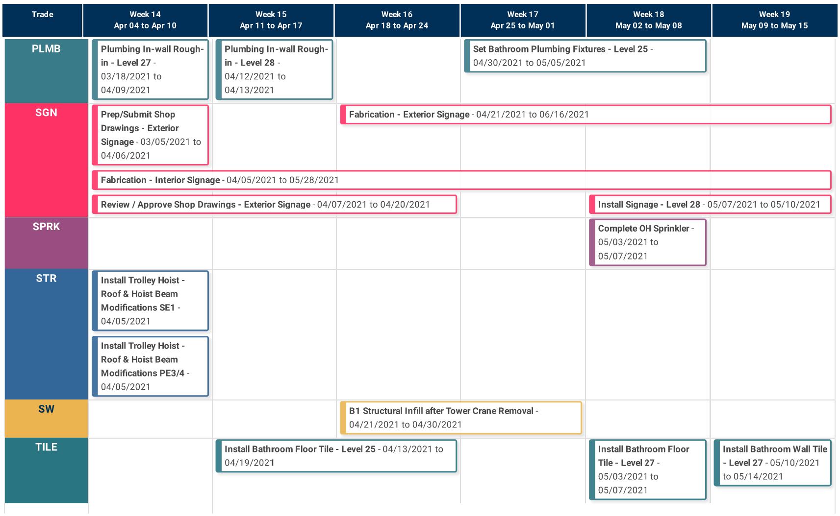
Schedule Reports – Calendar View

Slide 45
Questions?

