Slide 1



Leadership Matters

Slide 2
EQUIP: Leadership Matters
  Why Values Based Leadership Matters
  Why It Matters That Every Business Has Two Businesses
  Why It Matters That Leaders Provide Psychological Safety
  Why Relational Leadership Matters

Slide 3
Values Based Leadership
Leaders must be credible
Credibility starts with competence
Values-based behavior is next in importance
People want to follow leaders who model values
To be an authentic and effective leader, you have to be clear on your personal values and be able to articulate them in words and actions to yourself, your customers, and your followers.

Slide 4
Getting Clear on Your Values
How do you model your values?
First, you must be clear on what you value most.
Authenticity Adventure Balance
Bravery Compassion Challenge
Citizenship Community Creativity
Curiosity Determination Fairness
Freedom Friendships Fun
Generosity Growth Honesty
Influence Justice Kindness
Knowledge Leadership Learning
Love Loyalty Openness
Optimism Recognition Respect
Responsibility Security Self-Respect
Social Connection Spirituality Stability
Status Wealth Wisdom

Slide 5

Getting Clear on Your Values
How do you model your values?
First, you must be clear on what you value most.
www.personalvalu.es

Slide 6
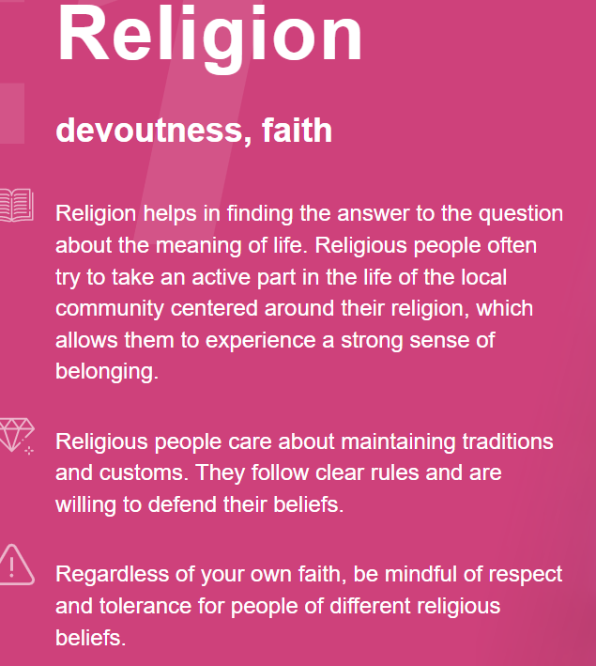
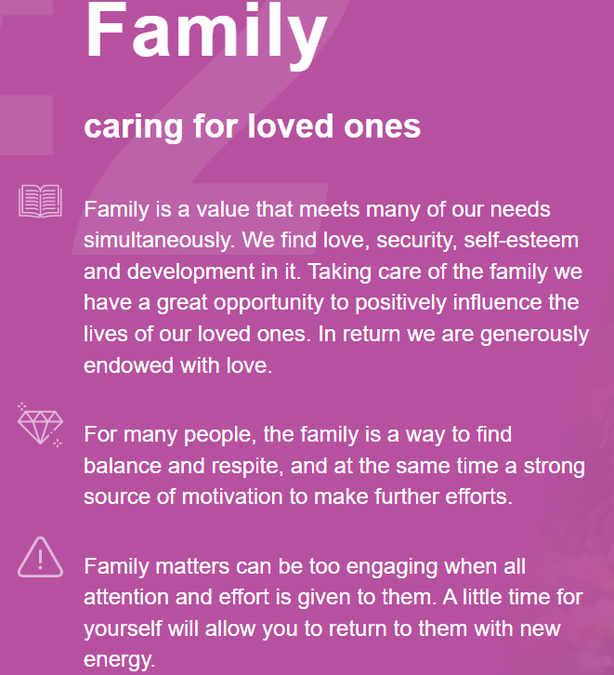
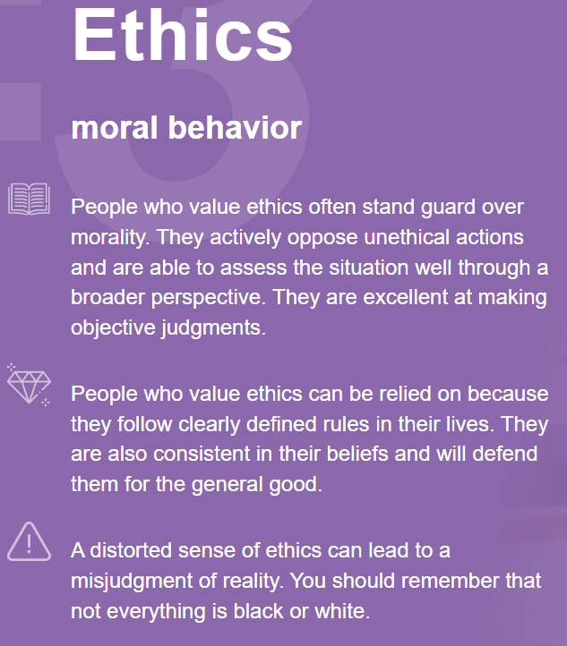
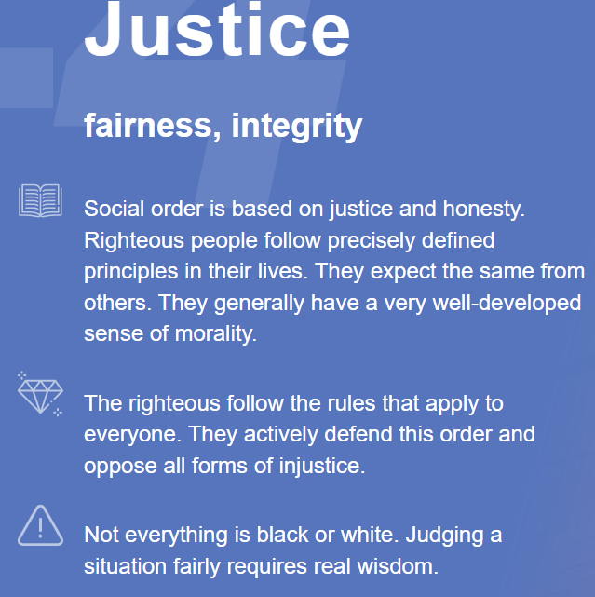
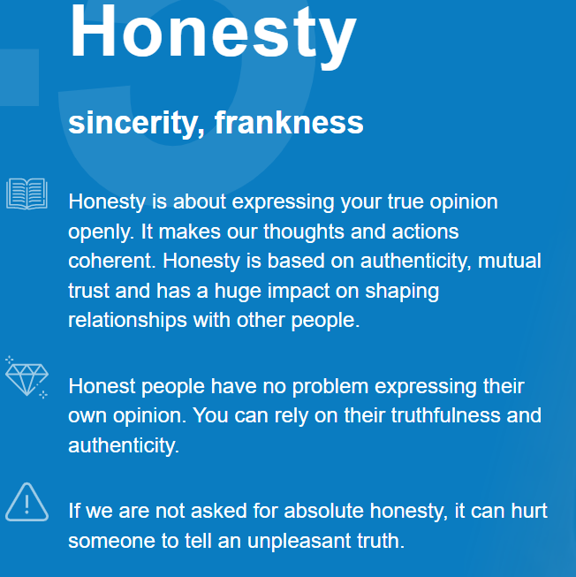
Getting Clear on Your Values
How do you model your values?
First, you must be clear on what you value most.

Slide 7
Getting Clear on Your Values
How do you model your values?
First, you must be clear on what you value most.
Creativity

Slide 8
Aligning Personal, Group, and Company Values
My Top 5 Personal Values
Your Company Values

Slide 9
Aligning Personal, Group, and Company Values
My Top 5 Personal Values
Ethics
Safety
Your Company Values
This Becomes Your Values Based Leadership Roadmap!

Slide 10
Equip: Leadership Matters
  Why Values Based Leadership Matters
  Why It Matters That Every Business Has Two Businesses

Slide 11
Every Business Must Have Two Businesses
  Business # 1 Is Your Business (What Your Company Does)
  Business #2 Is The Business of Building People!

Slide 12
Equip: Leadership Matters
  Why Values Based Leadership Matters
  Why It Matters That Every Business Has Two Businesses
  Why It Matters That Leaders Provide Psychological Safety

Slide 13
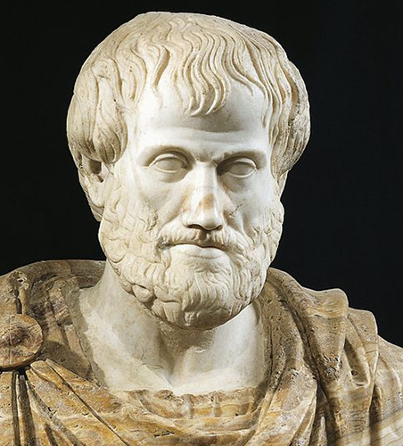
Psychological Safety
Project Aristotle
  “Why some teams succeed, and others fail?”
  “What makes a team successful?”
  Studied 180 Teams, analyzed 250+ attributes
  Determined 5 main attributes that contribute to success
  By far the most important attribute – more important than the other 4 combined:
  People on Teams Spoke Equal Amounts of Time!
  Psychological Safety

Slide 14
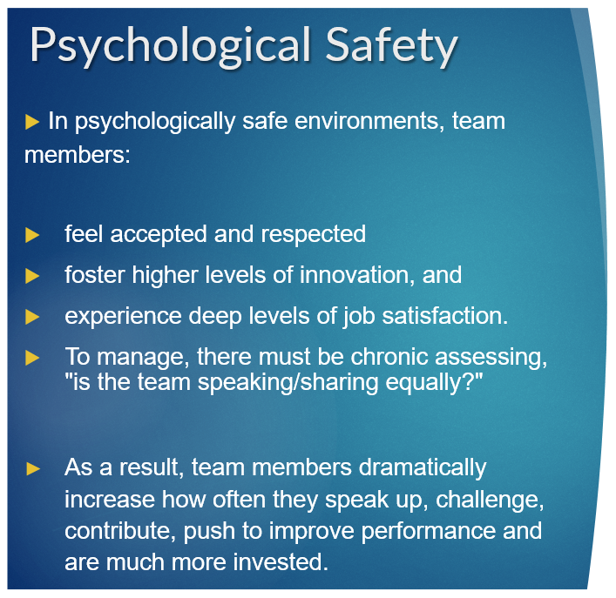


Slide 15
EQUIP: Leadership Matters
  Why Values Based Leadership Matters
  Why It Matters That Every Business Has Two Businesses
  Why It Matters That Leaders Provide Psychological Safety
  Why Relational Leadership Matters

Slide 16
Relational Leadership
Knows people deeply
You know how to reach each person
Extends trust and vulnerability
Mines for conflict with team
Leans into artificial harmony
Believes in serving others
Improves as a leader vs only believing only others need to grow as leaders

Slide 17

The Task Leadership Tension
A recognized leader who is known for getting the hardest jobs done.
Prioritizes tasks more than developing people – assigned bigger tasks.
CROSSROADS
Transition to becoming a relational leader or being a strong tasked based leader.
More Important Tasks
More Tasks
Start of the Job Tasks

Slide 18
The Task Leadership Tension
Rewarded with leading more people who complete tasks
Developing people becomes more important than tasks
Develops Ability to Lead People
CROSSROADS
Transition to becoming a relational leader or being a strong tasked based leader.
More Important Tasks
More Tasks
Start of the Job Tasks

Slide 19
Task vs Relational Leadership
Success = completion of tasks, getting stuff done
Success = depth of relationships, leading others to complete tasks
Hub and spoke leadership for maximum efficiency
A Leader who leads teams
Does not prioritize relationship issues
Mines, questions for conflict, leans into artificial harmony
Limited understanding of the uniqueness of each individual
Knows people so well, puts them in positions for success

Slide 20
Relational Leadership
The Payoff?
Team members are motivated
Psychological Safety is present
The truth is told
Team members grow so you can grow and everything can grow!

Slide 21
EQUIP: Leadership Matters
  Why Values Based Leadership Matters
  Why It Matters That Every Business Has Two Businesses
  Why It Matters That Leaders Provide Psychological Safety
  Why Relational Leadership Matters

